Slide 1
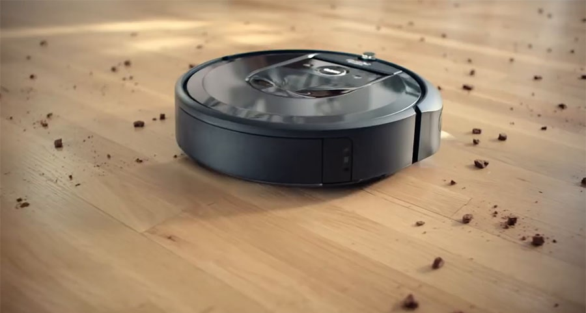
Actuators
Drive motors
Vacuum unit
Performance
Is the room clean?
Environment
Physical environment – a room
Sensors
Dirt sensor
Infrared sensors for walls/obstacles
Battery level
Dirt bin level

Slide 2
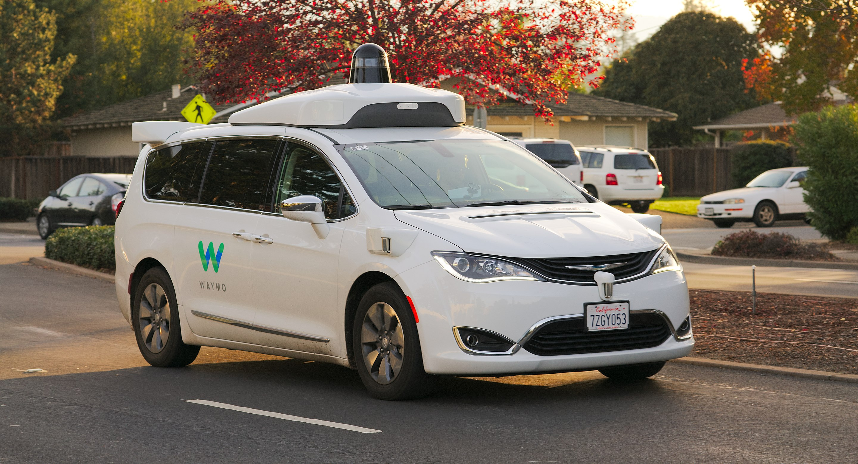
Performance
Reach the destination
Drive safely and legally
Actuators
Steering
Accelerator
Brake
Environment
Physical environment – road
Sensors
Camera
Infrared, radar, lidar, …
GPS

Slide 3

Performance
Perform customer service?
Pass the Turing test?
Actuators
Send text message
Environment
Instant messaging app
Sensors
Receive text message

Slide 4
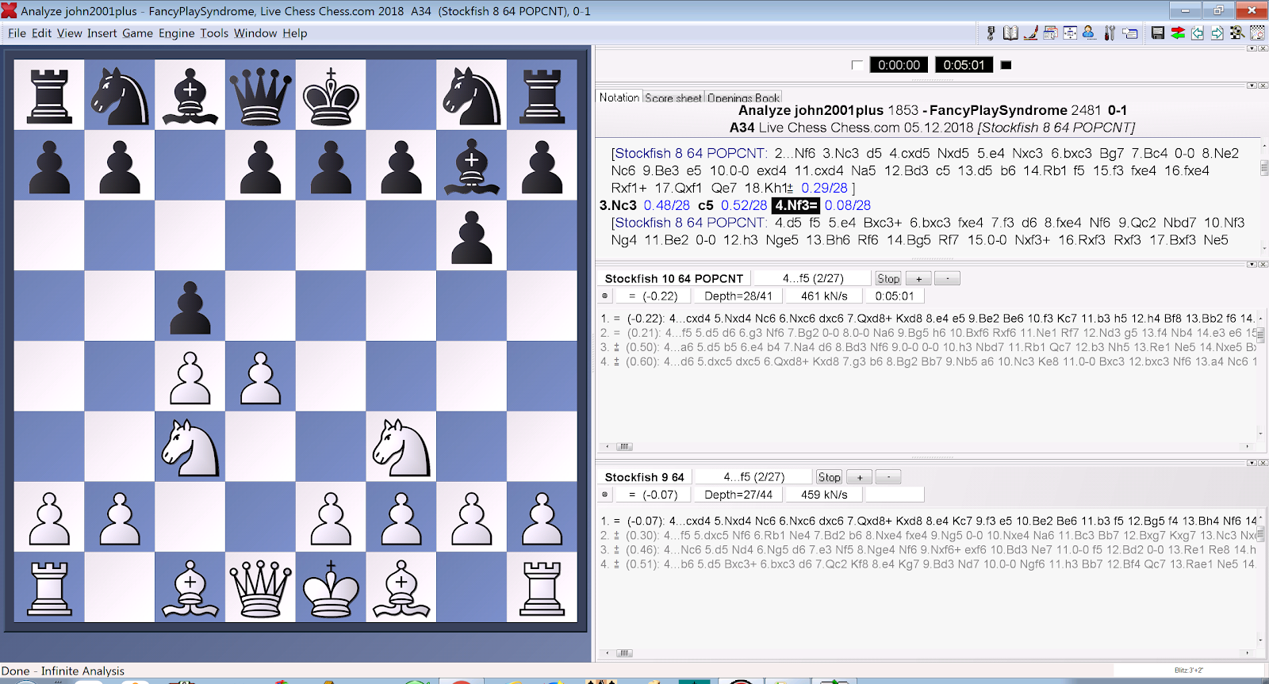
Performance
Win the game
Actuators
Make a move
Environment
Chess board
Sensors
Board state

Slide 5
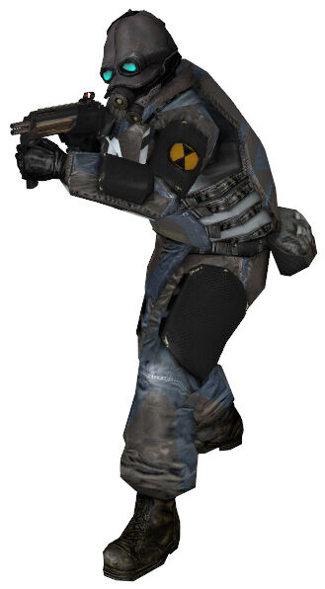
Performance
Kill the player?
Provide convincing behaviour?
Actuators
CharacterController.Move()
Shooting
Playing animations
Sensors
Raycasts
Player / NPC positions
Level geometry
Environment
Game world

Slide 6
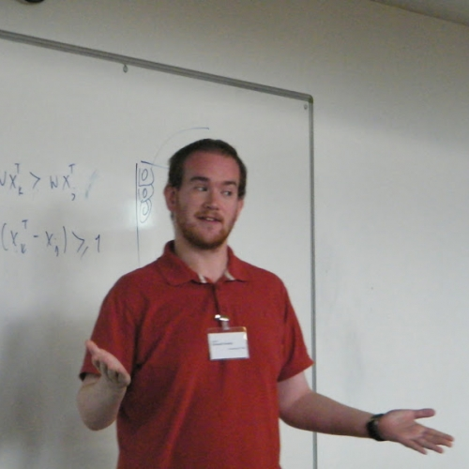
Performance
????
Actuators
Muscles
Vocal cords
Sensors
Eyes
Ears
Nose
Tongue
Skin
Environment
Real world

Slide 7
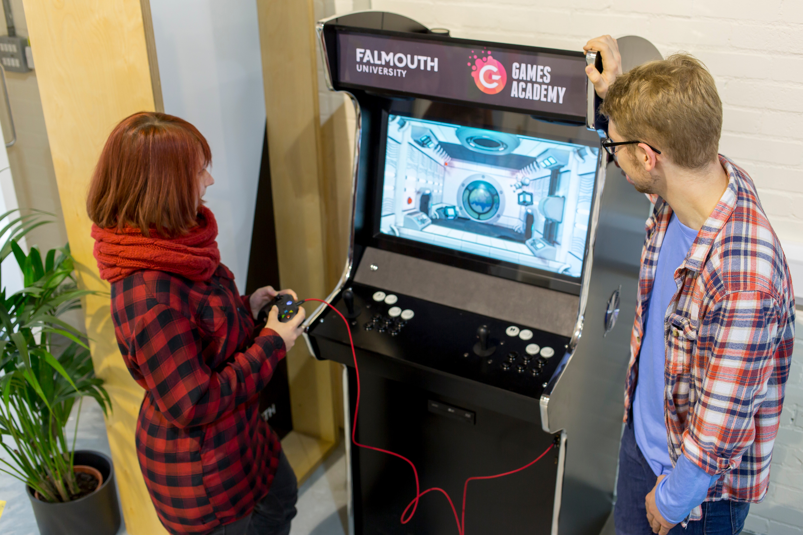
Performance
Win the game?
Have fun?
Actuators
Controller inputs
Sensors
Graphics
Sound
Haptic feedback
Environment
Game world

